Slide 1
Transformational Prayer Training 2018
History
Ed Smith’s
GACC
Not Just For Troubled People
Great For Personal Sanctification
Great For Discipling
Qualifiers

Slide 2
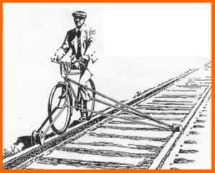
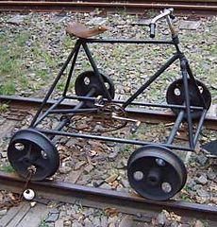
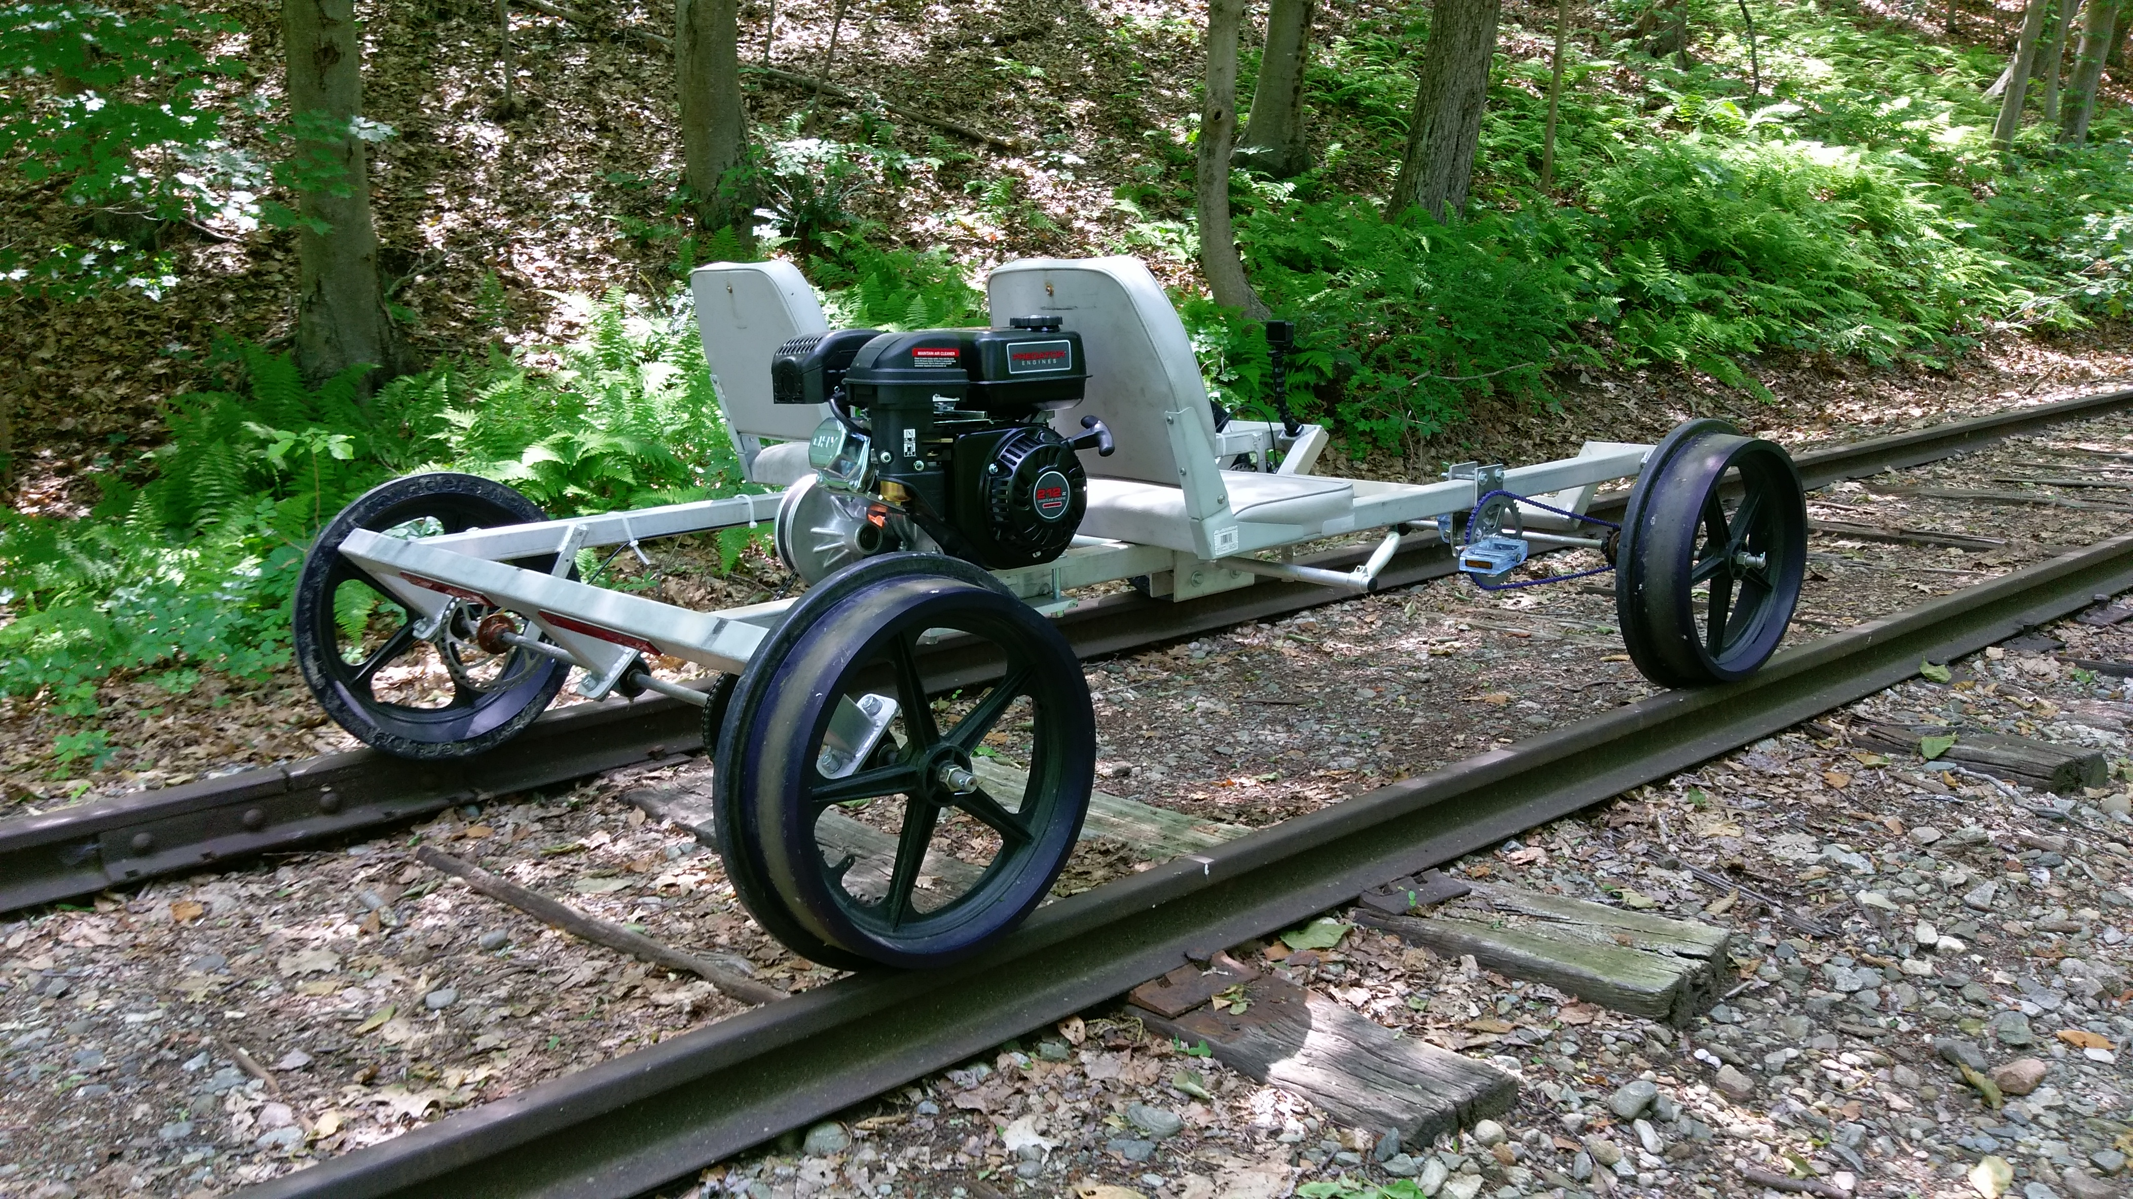
Examples Of The Christian Life:

Slide 3
Towards A Healthy Heart
Christopher Biang
2018

Slide 4
Your Life Will Flow From Your Heart
Proverbs 4:23 Watch over your heart with all diligence, For from it flow the springs of life.
My parents used to take us on picnics to Bennett Springs State Park in Missouri, this Spring puts out 100 million gallons of water each day. It hosts a trout hatchery as well. Imagine if someone dropped a poison in the spring, or in some way polluted it. The fish would die, farmers, towns and cities would all be affected by this.
Spring water has been an important part of our heritage. Pioneers congregated around good sources of water. Think of how many towns have the word spring in their name. Good consistently available water is the base of life. For example Chicago used to get their water from Lake Michigan, and also dump their effluent into the Lake. The result, many people dying from cholera, until Chicago guarded their water source by reversing the Chicago river. So to, we should watch over our heart/spring because our life is at stake. So, what is affected if we allow pollutants into our hears? Who or what is heart if we are not producing springs of life.

Slide 5
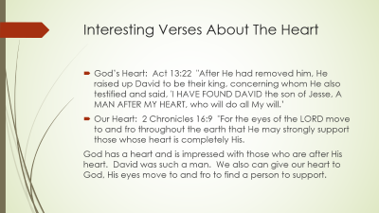
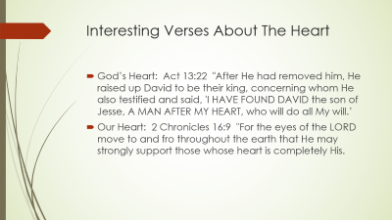
What Is Heart Health Ministry?
Matthew 22:37 And He said to him, " 'YOU SHALL LOVE THE LORD YOUR GOD WITH ALL YOUR HEART, AND WITH ALL YOUR SOUL, AND WITH ALL YOUR MIND.' 38 "This is the great and foremost commandment.
The word Heart is the Greek word: Kardia…this is the center or seat of our spiritual life (Thayer)
To contrast heart with mind, is that the mind has thoughts, facts and observations. Conviction and beliefs are that come from the heart. The term double-minded comes from having two different “beliefs” in the heart that are in conflict.
To contrast the heart with soul, is that the soul is your essence that carries on after death. Heart health ministry is the replacing of lies with God given truth.

Slide 6
Interesting Verses About The Heart
God’s Heart: Act 13:22 "After He had removed him, He raised up David to be their king, concerning whom He also testified and said, 'I HAVE FOUND DAVID the son of Jesse, A MAN AFTER MY HEART, who will do all My will.’
Our Heart: 2 Chronicles 16:9 "For the eyes of the LORD move to and fro throughout the earth that He may strongly support those whose heart is completely His.
God has a heart and is impressed with those who are after His heart. David was such a man. We also can give our heart to God, His eyes move to and fro to find a person to support.

Slide 7
How Does The Heart Work?
Imagine trying to operate your computer with two or more operating systems running at the same time. This in some ways happens to us, the Bible calls it being doubleminded unstable in all its ways…James 1:8
The heart is the repository of our beliefs. Either good or bad. We have the capacity to own conflicting beliefs which leads to difficulties functioning properly. Our beliefs come from experience, imprinting, God’s Word, Satan’s lies, etc. We can memorize God’s Word and force ourselves to act on it. Yet if there is an underlying conflicting belief, we will in times of stress default to the underlying heart held belief.
Heart held truth usually results in pleasant emotions (see Gal. 5.22)
Heart held lies usually result in unpleasant emotions (fear, shame, inferiority, etc.)
Heart held truth can also lead to unpleasant emotions (sadness, grief, etc.) this is dealt with differently

Slide 8
Exercise One: Becoming Aware Of Your Countenance
Genesis 4:5 but for Cain and for his offering He had no regard. So Cain became very angry and his countenance fell. 6 Then the LORD said to Cain, "Why are you angry? And why has your countenance fallen? 7 "If you do well, will not your countenance be lifted up? And if you do not do well, sin is crouching at the door; and its desire is for you, but you must master it."
Look up what countenance means:
Assess your countenance right now: (How are you feeling)
(Use Chart)
Try to assess your emotions right now, see if an event comes to mind where you felt these before.
What do you believe about that situation?

Slide 9
Christian Sanctification And Renewing The Mind
Romans 12:2 And do not be conformed to this world, but be transformed by the renewing of your mind, so that you may prove what the will of God is, that which is good and acceptable and perfect.
2 Tim. 2:24 The Lord's bond-servant must not be quarrelsome, but be kind to all, able to teach, patient when wronged, 25 with gentleness correcting those who are in opposition, if perhaps God may grant them repentance leading to the knowledge of the truth, 26 and they may come to their senses and escape from the snare of the devil, having been held captive by him to do his will.
Continued:

Slide 10
Continued:
Transformation happens by renewing our minds
Transformation happens when God grants us repentance*
Methodology:
Reading God’s Word, and doing it
Discovering lie based thinking, looking to God for truth in prayer
Ephesians 1:18 I pray that the eyes of your heart may be enlightened, so that you will know what is the hope of His calling, what are the riches of the glory of His inheritance in the saints,
* repentance: metanoia Thayer Definition
1) a change of mind, as it appears to one who repents, of a purpose he has formed or of something he has done

Slide 11
Common Practice Of Sanctification:
Hear God’s Word, meditate, memorize, obey
It may be held in your heart with no doubt or push back, it becomes your faith
Or It may contrast with a lie based belief resulting in doubt or doubleminded behavior
James 4:8 Draw near to God and He will draw near to you. Cleanse your hands, you sinners; and purify your hearts, you double-minded.
James 1:8 being a double-minded man, unstable in all his ways.
Methods of the Past: separation from distraction and seeking God in prayer, often with fasting
Now: Healing prayer ministries, discovering lies and letting God speak to them

Slide 12
How Do We Deal With Unstable Ways And Doublemindedness?
We make up solutions:
We put on work mode, and don’t let our emotions come into our day
We self-medicate, with a plethora of pleasure inducing items or pastimes so as to avoid pain
We shut down all emotions
We avoid all things which stir us up
We allow anger to protect us

Slide 13
What Is The Result Of Our Solutions:
We can become cold hearted
We can become blind to our issues
We become driven to experience pleasure which hides pain
We are unaware of our emotions
We hurt people through our anger
We spend an inordinate amount of energy guarding our actions
We are often distant from God and others
No real heart change-not a very joyful life

Slide 14
What are the differences between feelings and emotions?
Different writers use these words interchangeably. For our purposes we will use feelings to refer to that which starts from our physical sensors. Emotions will come from our belief system. Sometimes emotions will bleed into our feelings. If we sense fear (emotion) our body may tense up and we physically feel the emotion. Internal issues can be confusing. Hebrews 4:12 For the word of God is living and active and sharper than any two-edged sword, and piercing as far as the division of soul and spirit, of both joints and marrow, and able to judge the thoughts and intentions of the heart. So, to have exact definitions is difficult.

Slide 15
So What Do We Do?
Hebrews 5:11 Concerning him we have much to say, and it is hard to explain, since you have become dull of hearing. 12 For though by this time you ought to be teachers, you have need again for someone to teach you the elementary principles of the oracles of God, and you have come to need milk and not solid food.13 For everyone who partakes only of milk is not accustomed to the word of righteousness, for he is an infant. 14 But solid food is for the mature, who because of practice have their senses trained to discern good and evil.
Become aware of and train your senses (See Exercise One)
Move to exercise two next week: Become aware of what others think

Slide 16
Exercise Two:
Romans 12:3 For through the grace given to me I say to everyone among you not to think more highly of himself than he ought to think; but to think so as to have sound judgment, as God has allotted to each a measure of faith.
Since this verse says to have sound judgment….
Ask someone who you trust to give you an assessment of your life. What we are looking for is an accurate assessment of your strengths, weaknesses and spirituality.
This will help us in our humility. It is healthy to have a bit of doubt about our self. It is to easy to be proud and decide we don’t need the Body or the Head.

Slide 17
Exercise Two Questions: Caution: if you don’t want to hear the answers, you may not want to ask the questions
What are my strengths?
What are my weaknesses?
If you could tell me three areas to work on what would they be?
What are some of the best things I do?
What do I do that irritates people?
What do you think I am blind to?
What are my spiritual gifts?

Slide 18
So How Does Transformational Heart Prayer Work?
A person notices an emotional pain
They feel the pain, and watch for an associated memory
They consider the memory
They ask why do I feel this way?
The thought is usually the belief held in the heart.
This belief may appear irrational
You submit this to the Lord for His truth-He speaks
You test the belief by asking if it stills feels true.
Usually God will give a new understanding erasing the old belief
Sometimes we run into problems in the process…….

Slide 19
How Do We Deal With Solutions That Are In Place?
We don’t like feeling pain, so a solution might pop up and take our pain away, just when we are trying to feel it.
Maybe we start feeling something yet anger pops up and stops the process. Anger may be our solution to other pain.
Maybe we start feeling and all of a sudden we lose focus, or get real sleepy, thus distracting the process.
All these solutions may be worked through by using the questions on the map.

Slide 20
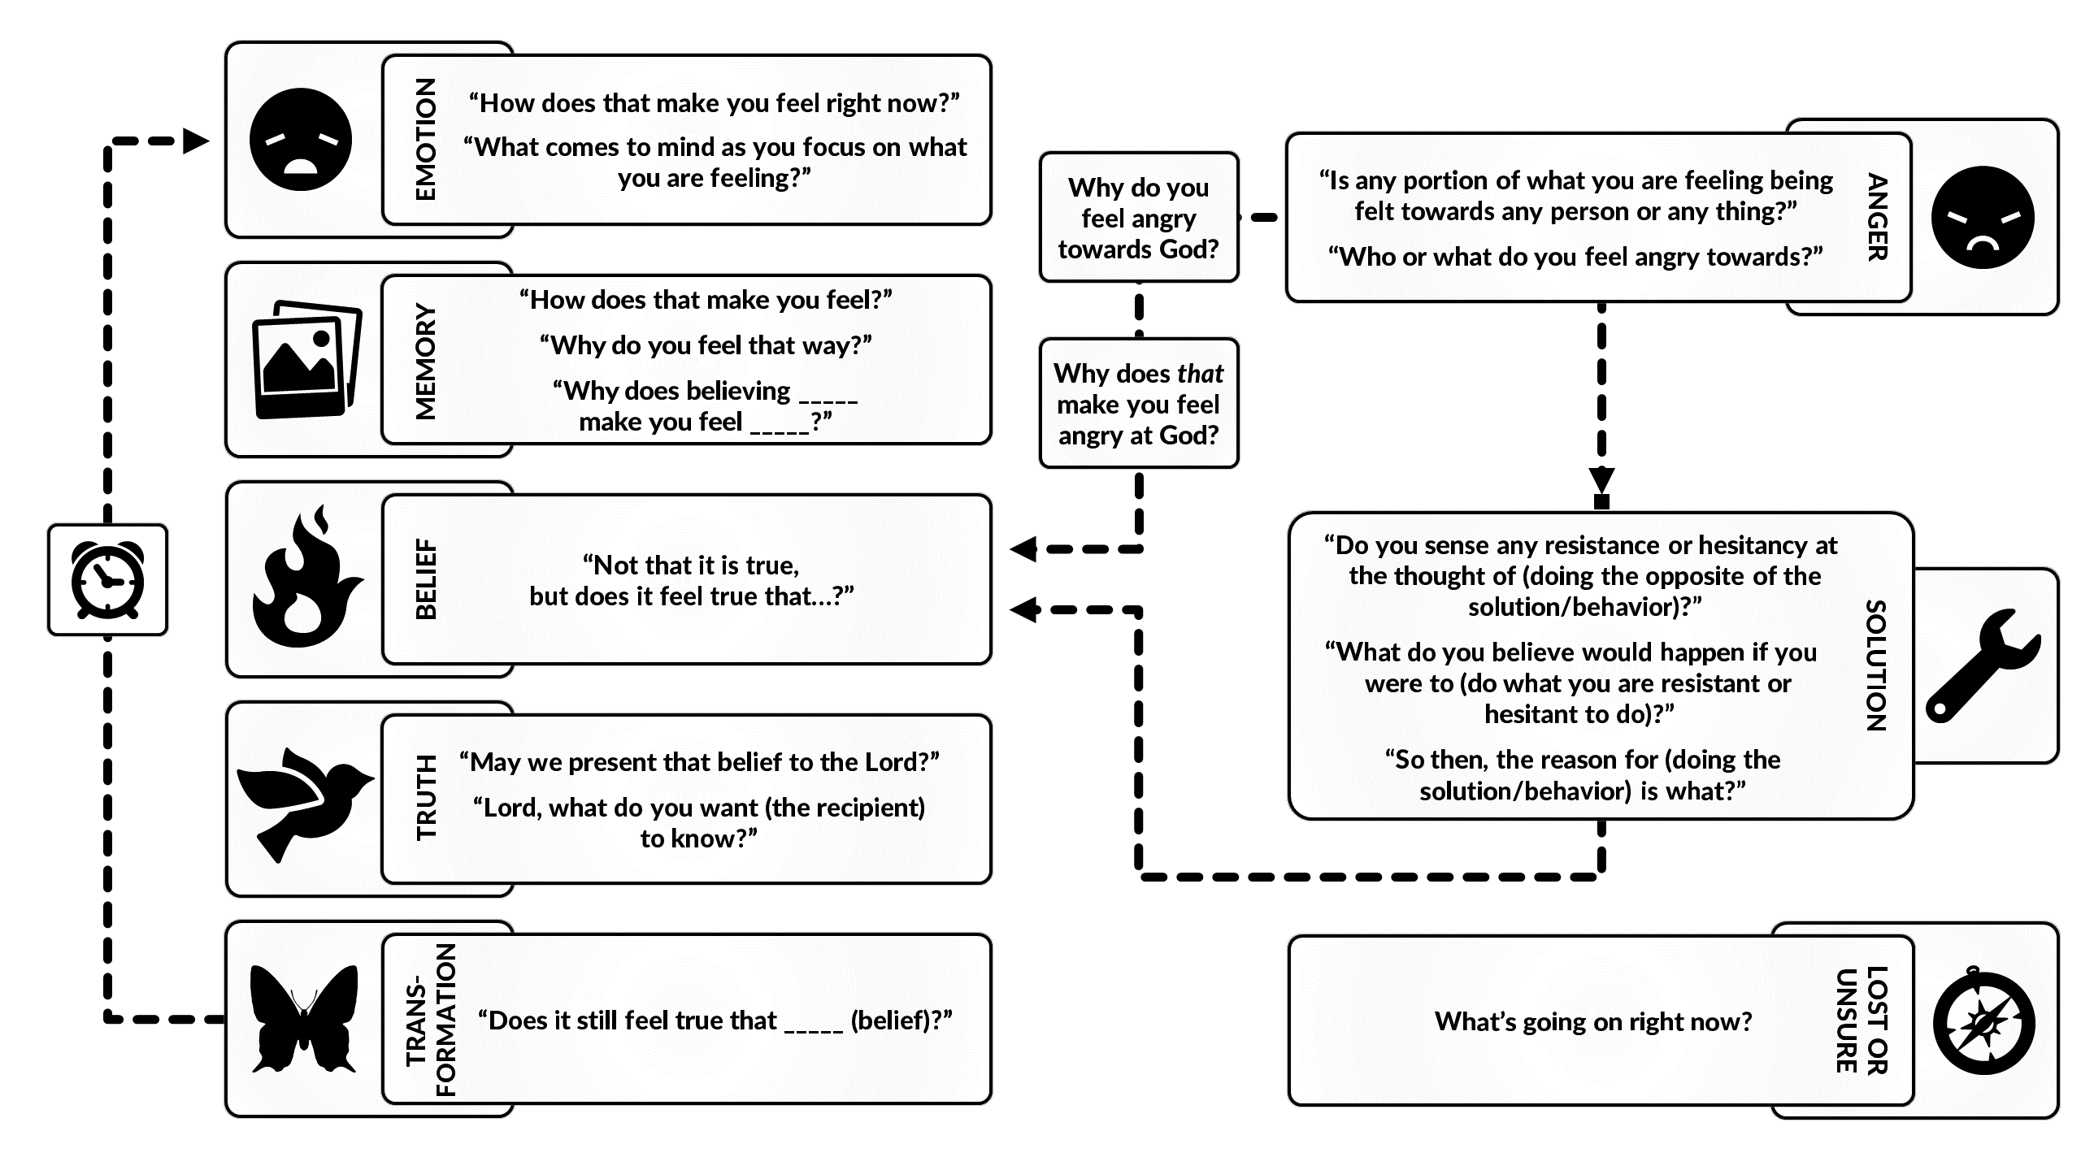
The Map

Slide 21
Where Does Emotional Pain Come From?
It seems like God created us to have emotions that correspond with our belief system.
Truth leads to fruit of the spirit feelings
Lies lead to feelings such as: abandonment, shame, fear, tainted, powerlessness, invalidation, hopelessness, confusion and anger related feelings
Truth can also lead to feelings of sadness and grief that are treated in a different way

Slide 22
Why Would I Want To Go Through All This Pain?
Pain is a indicator of an issue. It can be like the warning lights on a dashboard. Pain is then seen as useful in pointing out another issue that may be lurking under the hood
Pail is a motivator: children fear the pain that comes from discipline, so to, adults can use their aversion to pain to actually pursue removing that pain from their life
People can choose to live with the pain in their lives or choose to enter the pain with the idea of losing it altogether and replacing it with peace and a better walk with God

Slide 23
What Place Should Heart Ministry Play In My Life?
It plays a part just like the other disciplines, it is a set of tools to help in our sanctification

Slide 24
Sanctification Process Is Like A Railroad Track
Pre-Healthy Heart
Healthy Heart
Hear Word Of God
Unravel emotional hindrances-then obey despite feelings
Have a herky-jerky spiritual life
Accumulate emotional baggage over years
Slow down to just a limited form of outward spirituality
Cognitive Rail: hard to balance
Hear Word Of God
Unravel emotional hindrances, hear from God about these issues, obey with good emotions fully
Spiritual life begins to have a constancy of faith
Life and fruitfulness open up as you learn to abide in Christ
Heart and cognitive easier to balance

Slide 25
What Other Resources Are There For Heart Related Issues?
Wild At Heart Series of Books: John Eldredge
Emotionally Healthy Spirituality- Peter Scazzero (he has other books too)
Listening for heaven's sake : building healthy relationships with God, self, and others -Ping, Clipard
Soul Talk-Larry Crabb
Transformational Prayer Ministries: Ed Smith Online: http://www.transformationprayer.org/
Free online training, and demonstrations
Edge Venture- Men’s Retreats

Slide 26
Why Is “Heart Health” a big deal lately?
Emotion and prayer are a significant part of the Psalms
People are not given to large periods of time with God like in the past
We have too many distractions pulling us from God
When the devil works, God seems to provide solutions
The wisdom from God lately on how to access your heart is simple, and reproducible so people can own their walk with God
People talk about what excites them

Slide 27
What is the difference between heart ministry and counseling?
Giving counsel may be as simple as discussing relational issues how to get along, how and when to buy a car, how to study God’s Word. Information passing
Going To A Counselor: Trying to find out why you do what you do. Putting in place procedures to keep you from emotional difficulties. This may involve medications to alleviate bad feelings, it may involve physiological assessments as well….
Heart Ministry is often geared as a conversation of questions, pondering, and prayer. This can be done by anyone, more effectively if they are experienced, skilled and mature. The results should be lasting change. Some issues are beyond the scope of heart ministry, so having a trained professional to give advice is very helpful.

Slide 28
What Are The Downsides Of Heart Ministry?
There is a learning curve
This is not a quick fix, but a life process
It can be painful and raw at first
It needs to be in a grace environment
Some people do not like to go under the surface, they may be content with their issues.

Slide 29
What Are The Upsides Of Heart Healthy Ministry?
Simple resolution of anger
Openness in relationships
A better sense of abiding in Christ
Love increases
Discernment increases
Less down time

Slide 30
What Do I Do To Learn Heart Ministry?
It is good to learn as a team
Read and view all of the Books mentioned earlier, especially Ed Smith’s online training
Work with your pastors to introduce this to a few in the leadership team
Once the leadership team embraces this, then you can offer a class to continue learning and training

